Slide 2
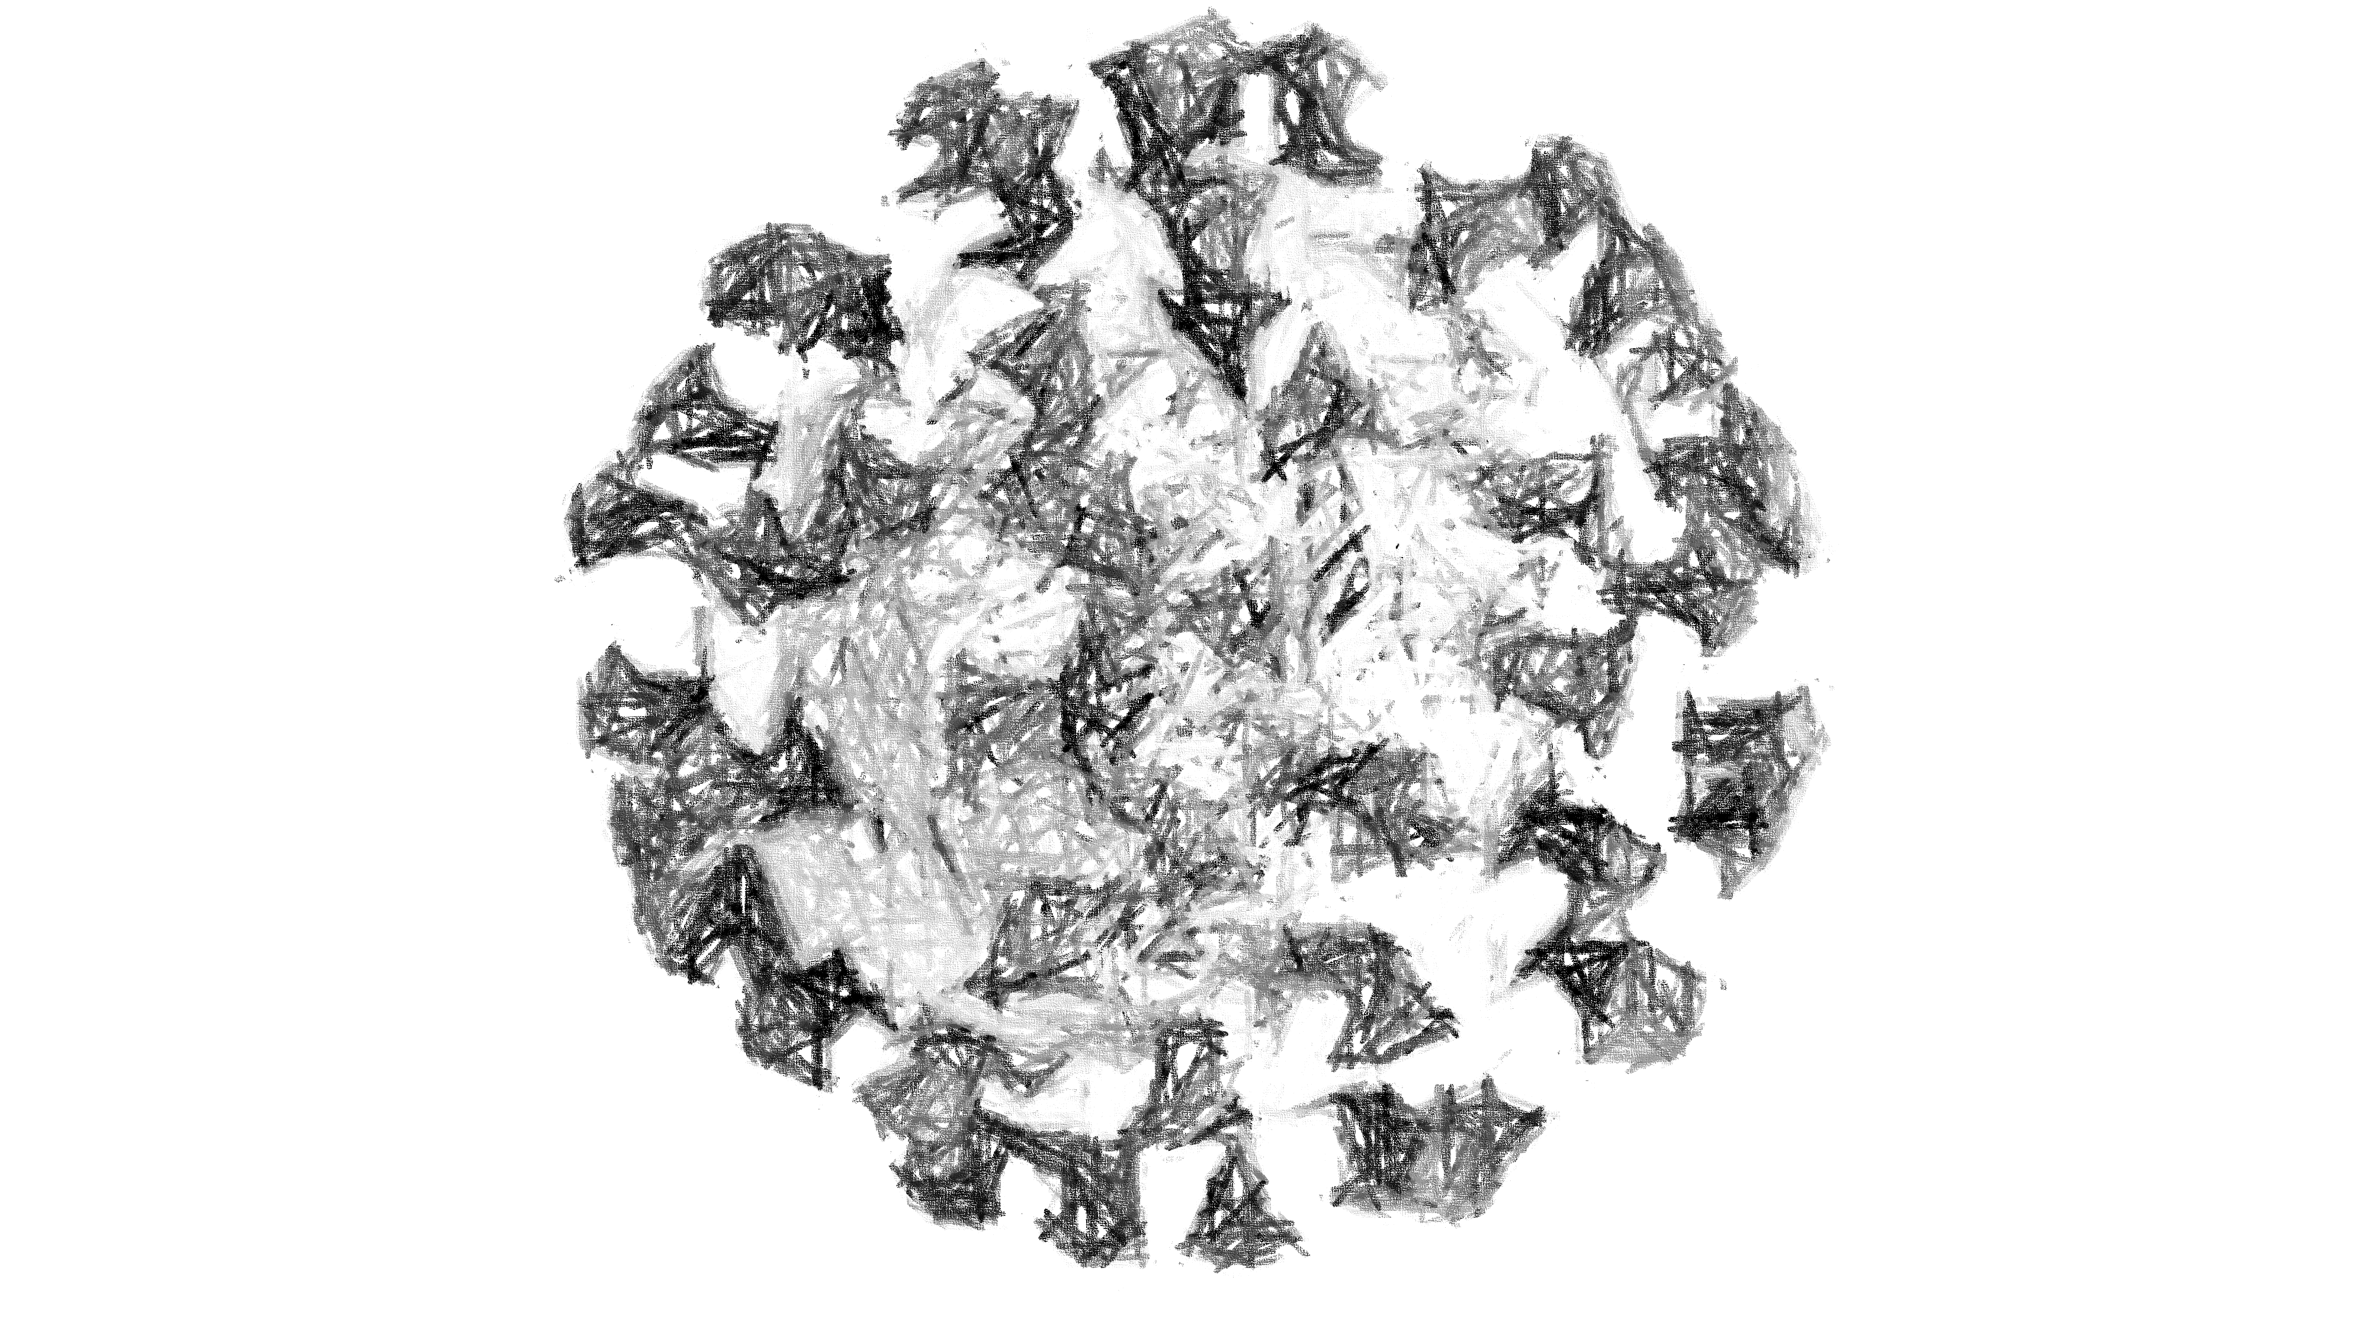




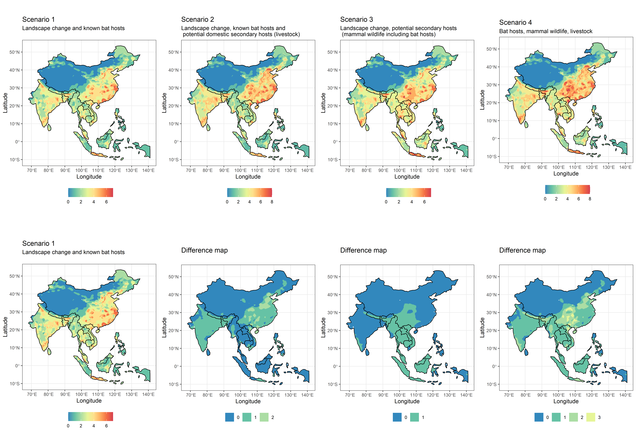

Slide 3
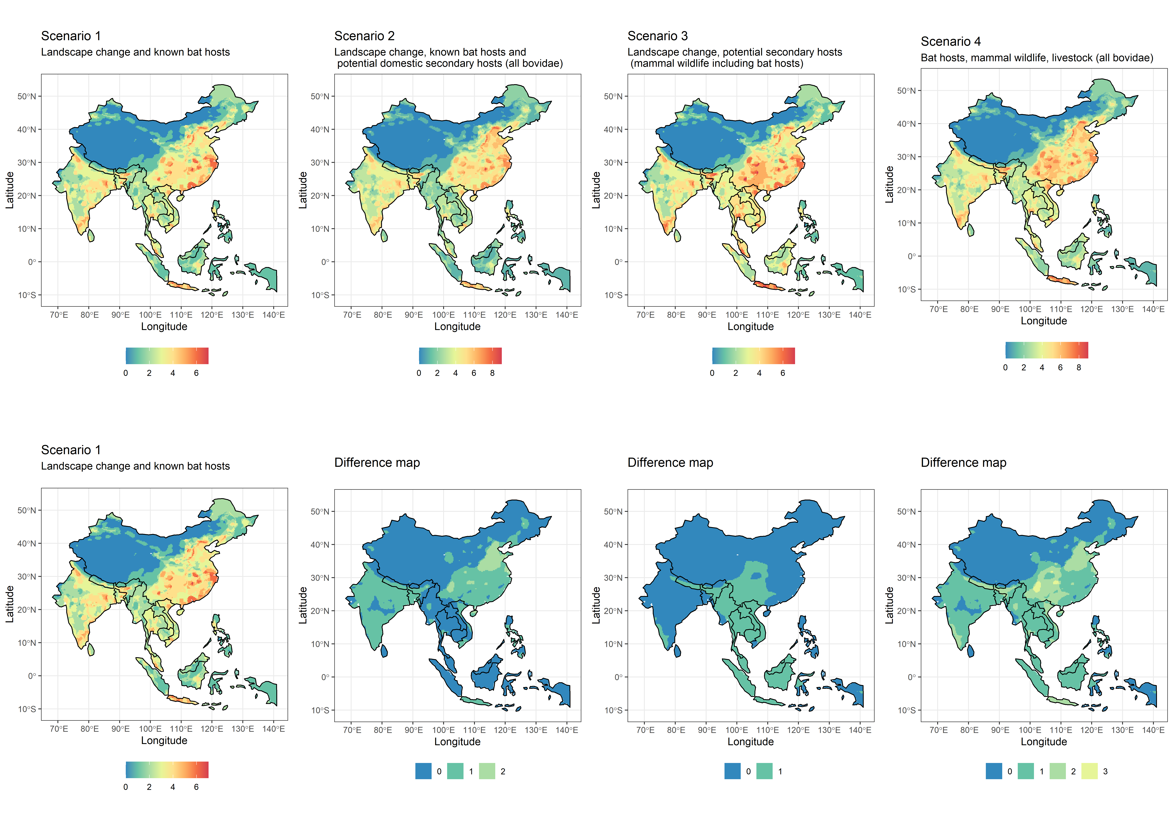

Slide 4
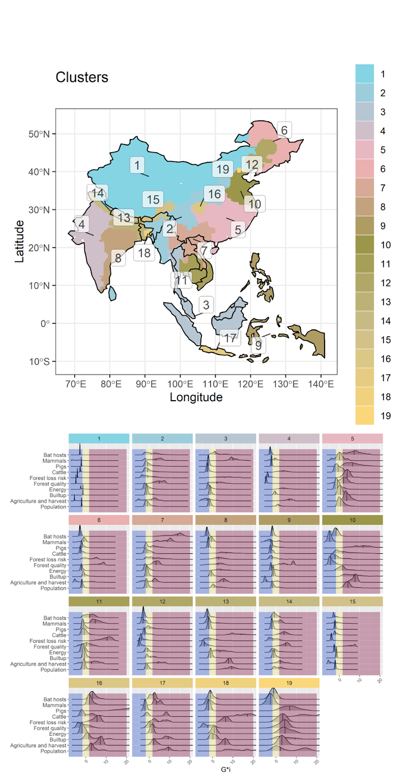
Cluster general geographical region names (indicative)
1 Inner-West China
2 Assam, West Burma block, Steppe, Sri Lanka
3 West Thailand, most of Sundaland islands
4 West India
5 Central China
6 Manchuria
7 North Lao PDR, North Vietnam, South China
8 East India
9 Philippines, Timor East, West Papua
10 North China
11 Southwest Indochina
12 Inner Manchuria
13 Nepal, Bhutan, Bangladesh
14 North India
15 South Lhasa and Arunachal Pradesh
16 Yuzhong District, Chongqing
17 Java
18 East Bangladesh
19 Beijing

Slide 5
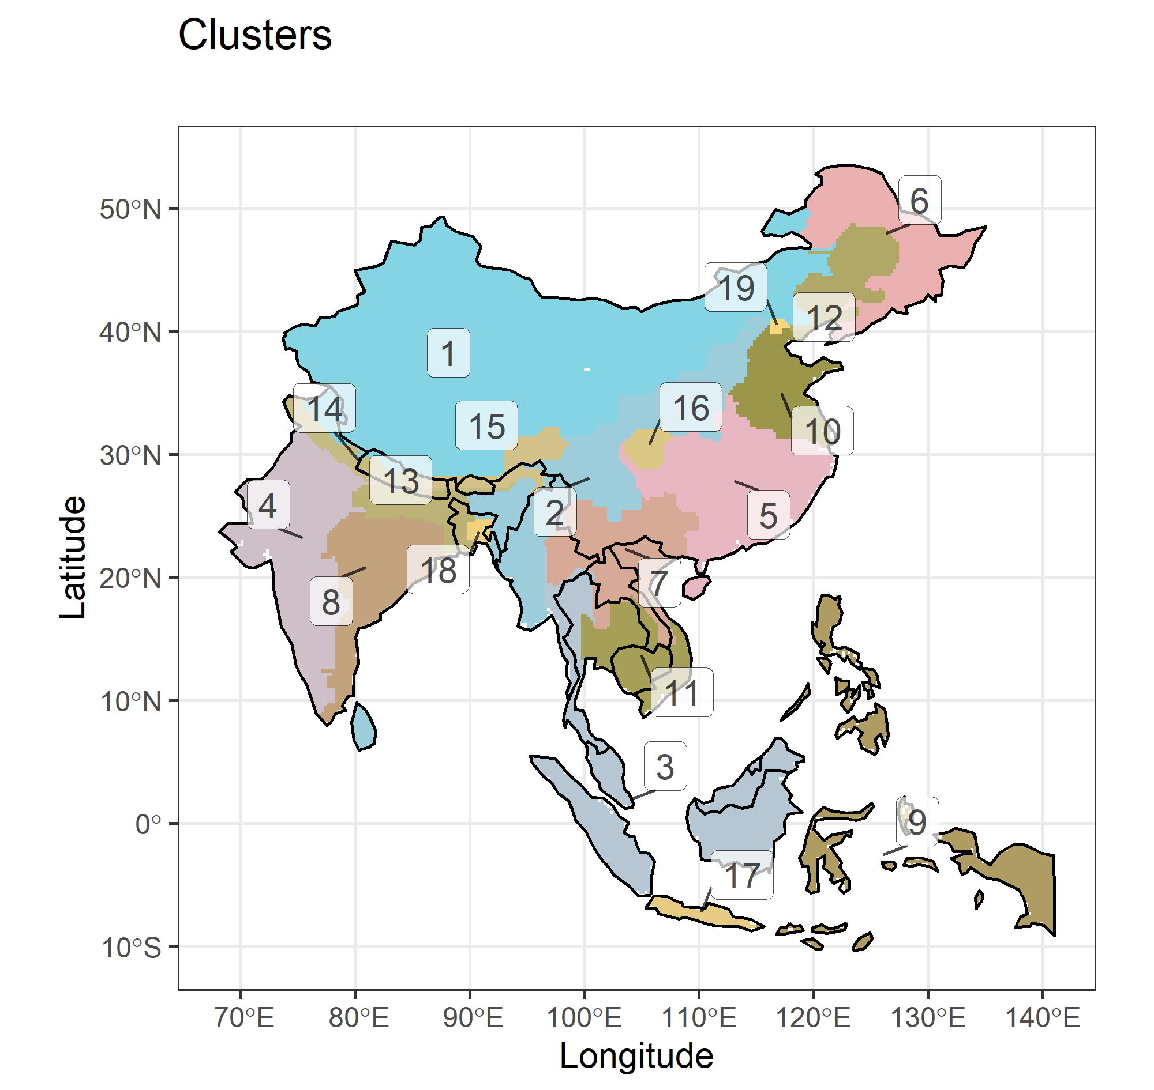
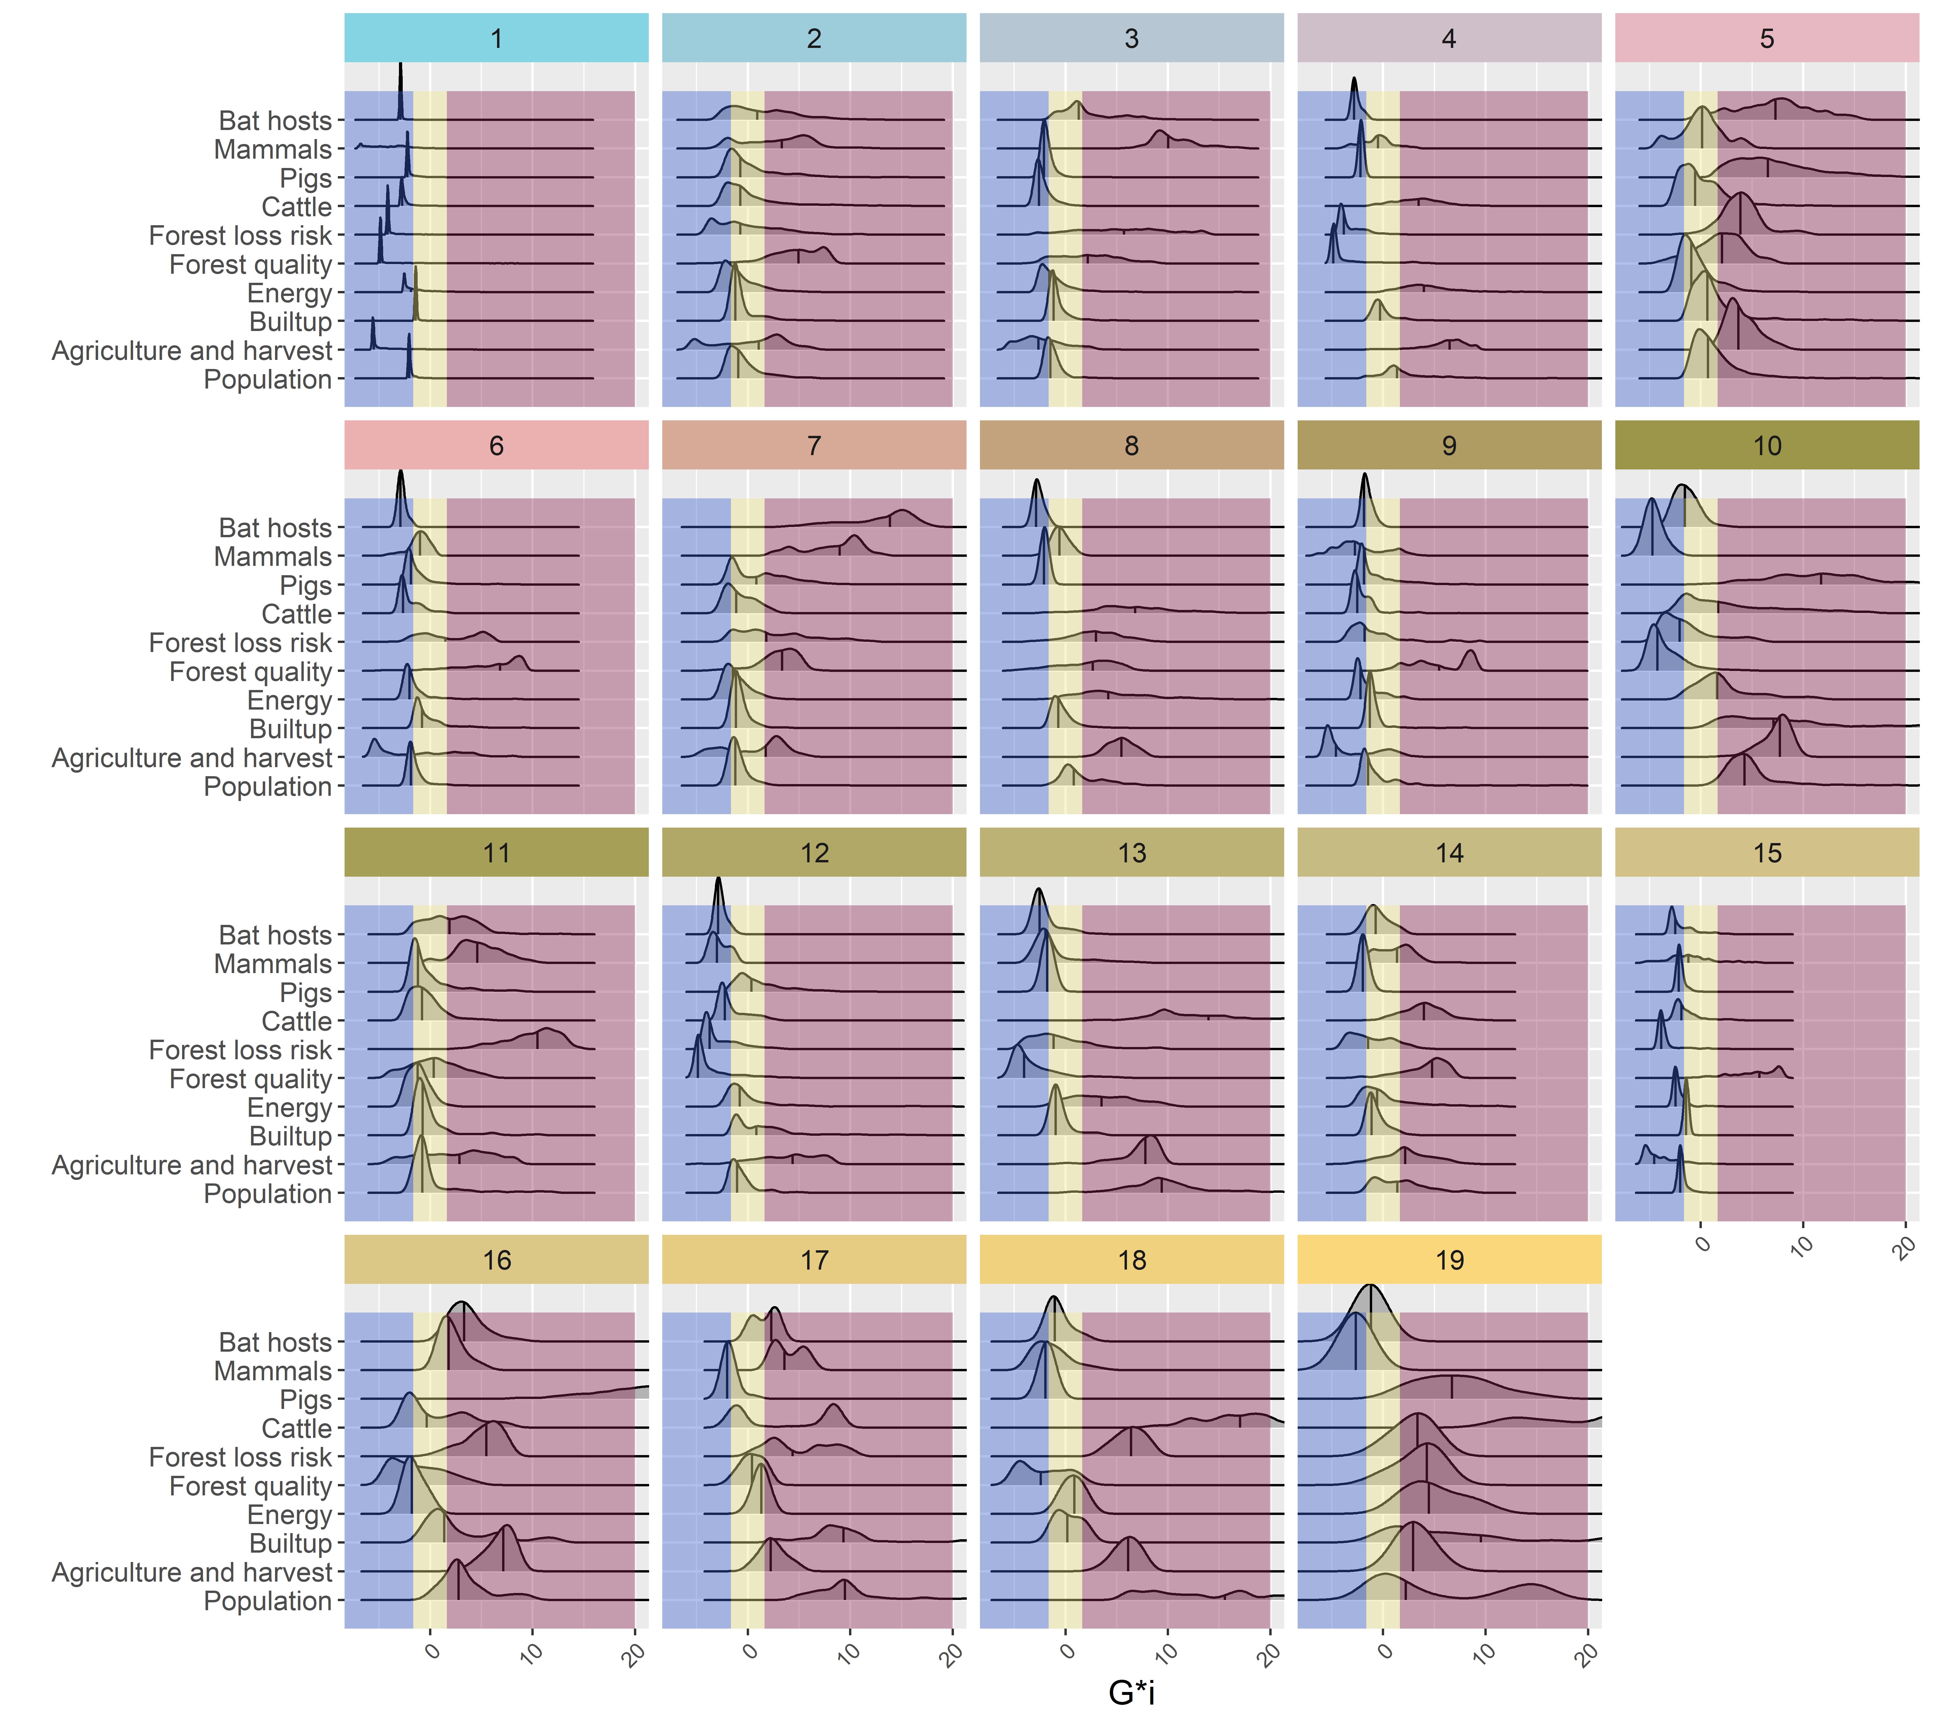

Slide 7
Cluster ID and region name (indicative) | N variables for which the median is a
 | Coldspot | Neutral spot | Hotspot | Total
1 Inner-West China | 9 | 1 | 0 | 10
2 Assam, West Burma block, Sri Lanka | 0 | 8 | 2 | 10
3 West Thailand, most of Sundaland islands | 3 | 4 | 3 | 10
4 West India | 4 | 3 | 3 | 10
5 Central China | 0 | 5 | 5 | 10
6 Manchuria | 6 | 3 | 1 | 10
7 North Lao PDR, North Vietnam, South China | 0 | 5 | 5 | 10
8 East India | 2 | 3 | 5 | 10
9 Philippines, Timor East, West Papua | 7 | 2 | 1 | 10
10 North China | 5 | 0 | 5 | 10
11 Southwest Indochina | 0 | 6 | 4 | 10
12 Inner Manchuria | 5 | 4 | 1 | 10
13 Nepal, Bhutan, Bangladesh | 4 | 2 | 4 | 10
14 North India | 1 | 6 | 3 | 10
15 South Lhasa and Arunachal Pradesh | 8 | 1 | 1 | 10
16 Shichuan and Yuzhong District, Chongqing | 2 | 2 | 6 | 10
17 Java | 1 | 2 | 7 | 10
18 East Bangladesh | 2 | 4 | 4 | 10
19 Beijing | 1 | 1 | 8 | 10
Total | 60 | 62 | 68 | 190

Slide 8
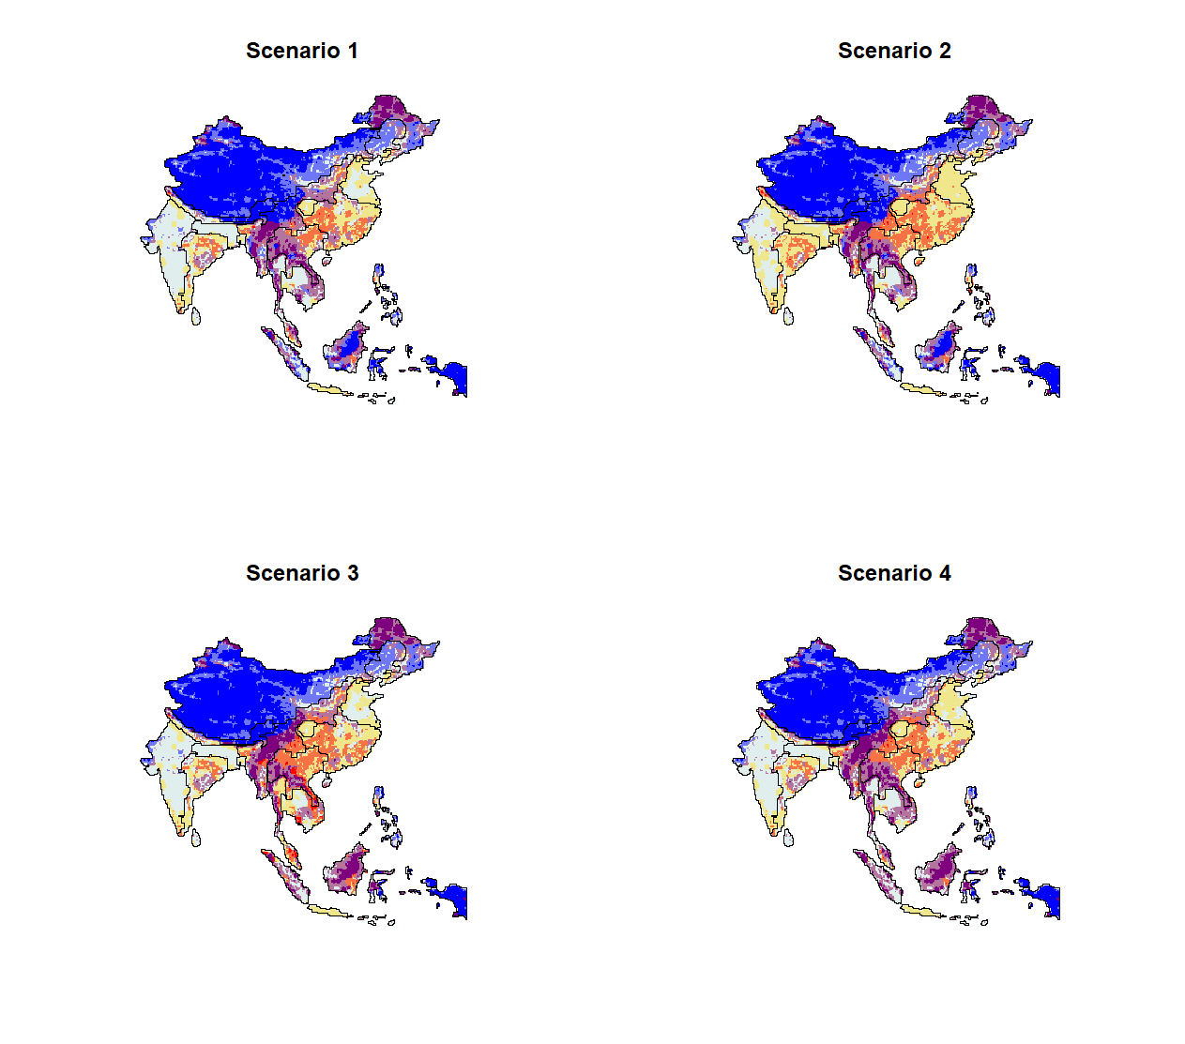
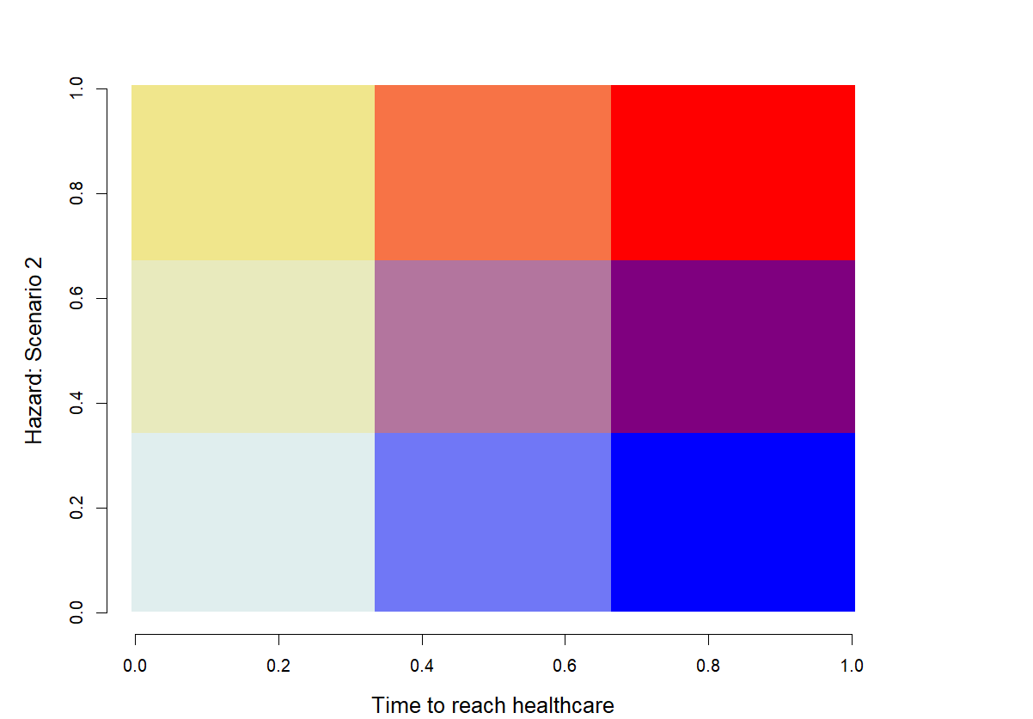
- Risk +
- Time to healthcare +

Slide 9
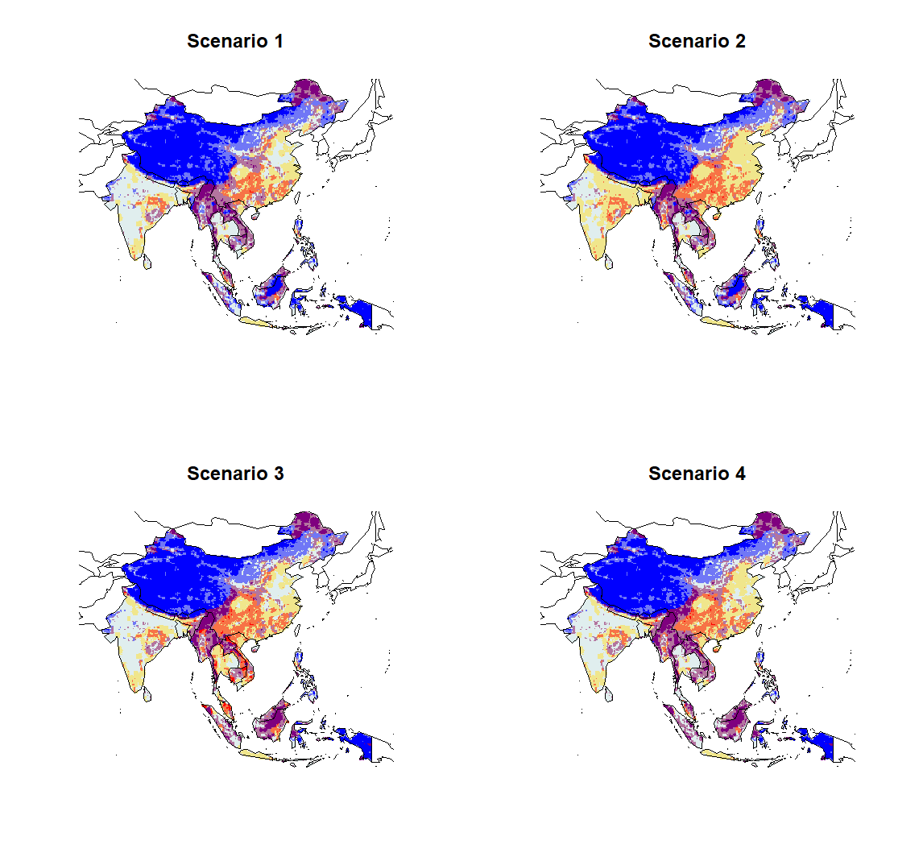
- Risk +
- Time to healthcare +

Slide 10
[,1] [,2] [,3] [,4]
[1,] "#E0EEEE" "#E0EEEE" "#7077F6" "#0000FF"
[2,] "#E0EEEE" "#E0EEEE" "#7077F6" "#0000FF"
[3,] "#E8EABD" "#E8EABD" "#B3759E" "#7F007F"
[4,] "#F0E68C" "#F0E68C" "#F77346" "#FF0000"
3
9
12
- Risk +
2
8
11
1
7
10
- Time to reach healthcare +

Slide 11
